Slide 1
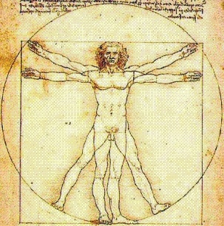
Unit 1, Pt 2
Introduction to Anatomical
Directions and Orientation

Slide 2
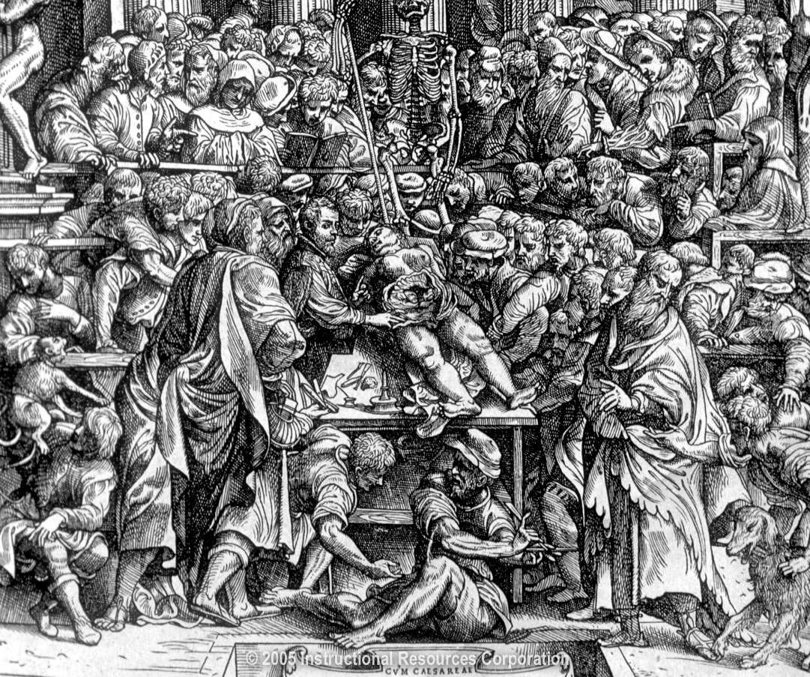
The Language of Anatomy
Special terminology is used to prevent misunderstanding
Exact terms are used for
Regions
Direction
Position
Structures

Slide 3
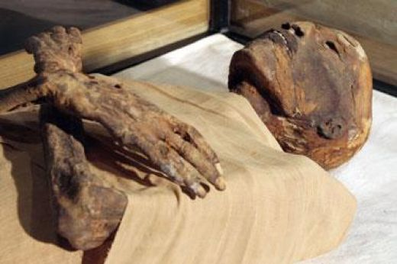
The Language of Anatomy: A Little History
Humans have been cutting open cadavers & dissecting corpses almost since the beginning of recorded human history.
Ancient Egyptians mummified their dead by cutting open bodies, dissecting out organs & preserving remains.
Ancient Greeks pursued human dissection, in much more of a scientific vein. Two early Greek physicians, Erasistratus (“first physiologist”) & Herophilus (“founder of human anatomy”) made the first systematic, scientific explorations of the human body.
Herophilus dissected the entire human body & differed from the authority at the time, Aristotle, when he claimed that consciousness was stored in the brain rather than in the heart.
Erasistratus explained the workings of human organs in mechanical terms.
The interest in human dissection almost “died” with the burning of the library of Alexandria & the widespread introduction of Christianity, when it became impossible to dissect human bodies anywhere in the Hellenistic world. For hundreds of years the European world valued the sanctity of the church more than scientific inquiry.

Slide 4
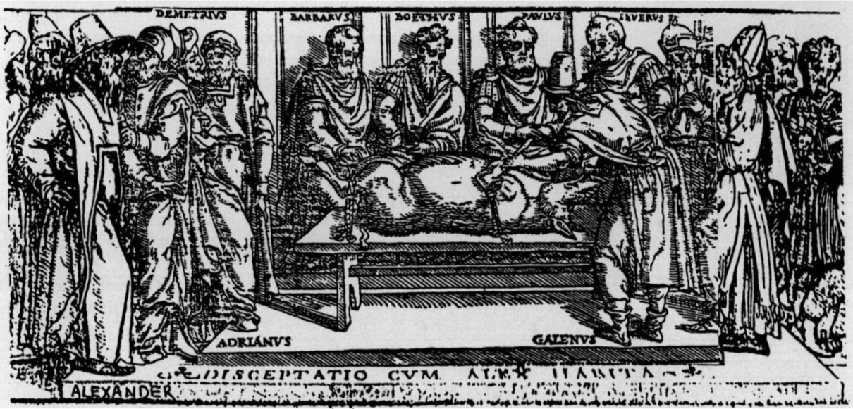
The Language of Anatomy: A Little History
Galen’s Anatomical Influence
The first of the great anatomists was Galen of Pergamon (AD 130-200) who made vast achievements in the understanding of the heart, the nervous system & the mechanics of breathing.
Because human dissection was forbidden, he performed many of his dissections on Barbary apes, which he considered similar enough to the human form.
The system of anatomy he developed was so influential that it was used for the next 1400 years. Galen continued to be influential into the 16th century, when a young & rebellious physician began the practice of using real human bodies to study the inner workings of the human body.

Slide 5
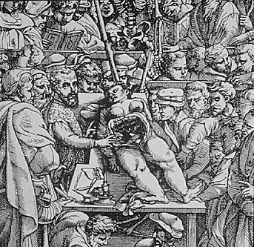
The Language of Anatomy: A Little History
Andreas Vesalius
As a child, Vesalius would catch & dissect small animals & later, as a medical student, he would obtain human remains to study.
At age 18, he entered the University of Paris, where they adhered to the works of Hippocrates & Galen. Medical professors thought it below themselves to perform dissections. During demonstrations, the professor would lecture on high as a barber-surgeon did the actual cutting on the dissection floor.
In France, physicians could obtain bodies to study, but lowly students, such as Vesalius, did not have direct access to any of these bodies. He raided the gallows of Paris for half-decomposed bodies & skeletons to dissect. Sometimes he would find the courage to steal cadavers from the mound of Monfaucon, where bodies of executed criminals were hung until they disintegrated.
During only his second anatomical lecture, Vesalius stepped onto the dissecting floor, took the knife away from the barber-surgeon & began cutting at the cadaver himself, demonstrating his great skill with the knife.

Slide 6
Anatomical Position
Body upright
Hands at sides
Palms facing forward
Feet together, flat on ground & facing forward
Eyes open
Go ahead & stand on up!

Slide 7
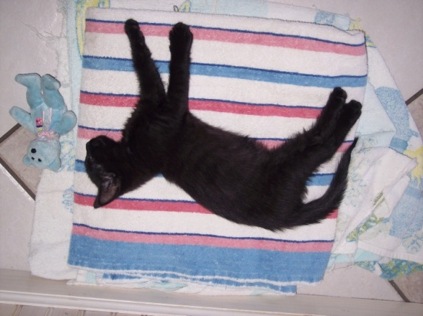
Anatomical Position – Supine vs. Prone
Supine –
Lying with the front or face & hands facing upward
Prone –
Lying with the front or face & hands facing downward

Slide 8
Directional Terminology
Superior (cephalic/cranial) vs. Inferior (caudal)
Anterior (ventral) vs. Posterior (dorsal)
Lateral vs. Medial (mesial)
Proximal vs. Distal
Superficial vs. Deep
You need
4 colored pencils
to complete your
Directional Terms handout!

Slide 9
Superior vs. Inferior
Superior (cranial/ cephalic) –
Toward the head
i.e. - The forehead is superior to the nose.
Inferior (caudal) –
Away from the head
i.e. - The navel is inferior to the breastbone.
Superior
Inferior

Slide 10
Anterior vs. Posterior
Anterior (ventral) –
Toward the front of the body
i.e. - The breastbone is anterior to the spine.
Posterior (dorsal) –
Toward the back of the body
i.e. - The heart is posterior to the breastbone.
Anterior (Ventral)
Posterior (Dorsal)

Slide 11
Medial vs. Lateral
Medial –
Toward the midline of the body
i.e. - The heart is medial to the arm.
Lateral –
Away from the midline of the body
i.e. - The arms are lateral to the chest.
Medial
Lateral

Slide 12
Proximal vs. Distal
Proximal –
Closer to the origin of the body part or the point of attachment of a limb to the body trunk
i.e. - The elbow is proximal to the wrist.
Distal –
Farther from the origin of a body part or the point of attachment of a limb to the body trunk
i.e. - The knee is distal to the thigh.

Slide 13
Superficial vs. Deep
Superficial (external) –
Toward or at the body surface
i.e. - The skin is superficial to the skeleton.
Deep (internal) –
Away from the body surface
i.e. - The lungs are deep to the ribcage.

Slide 14
Brain Break!
3
4
3
5
2
1
6

Slide 15
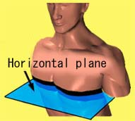
Anatomical Planes & Sections
Have out & complete the Planes handout!
Frontal (coronal) – divides the body into anterior/ posterior parts
Transverse (horizontal) – divides the body into superior/ inferior parts
Also known as a cross-section

Slide 16
Anatomical Planes & Sections
Sagittal – divides the body into right & left parts
Midline/midsagittal/median
Parasagittal – divides the body into unequal right & left sides/off-centered
Sagittal (midsagittal) plane
Para
Midline

Slide 17
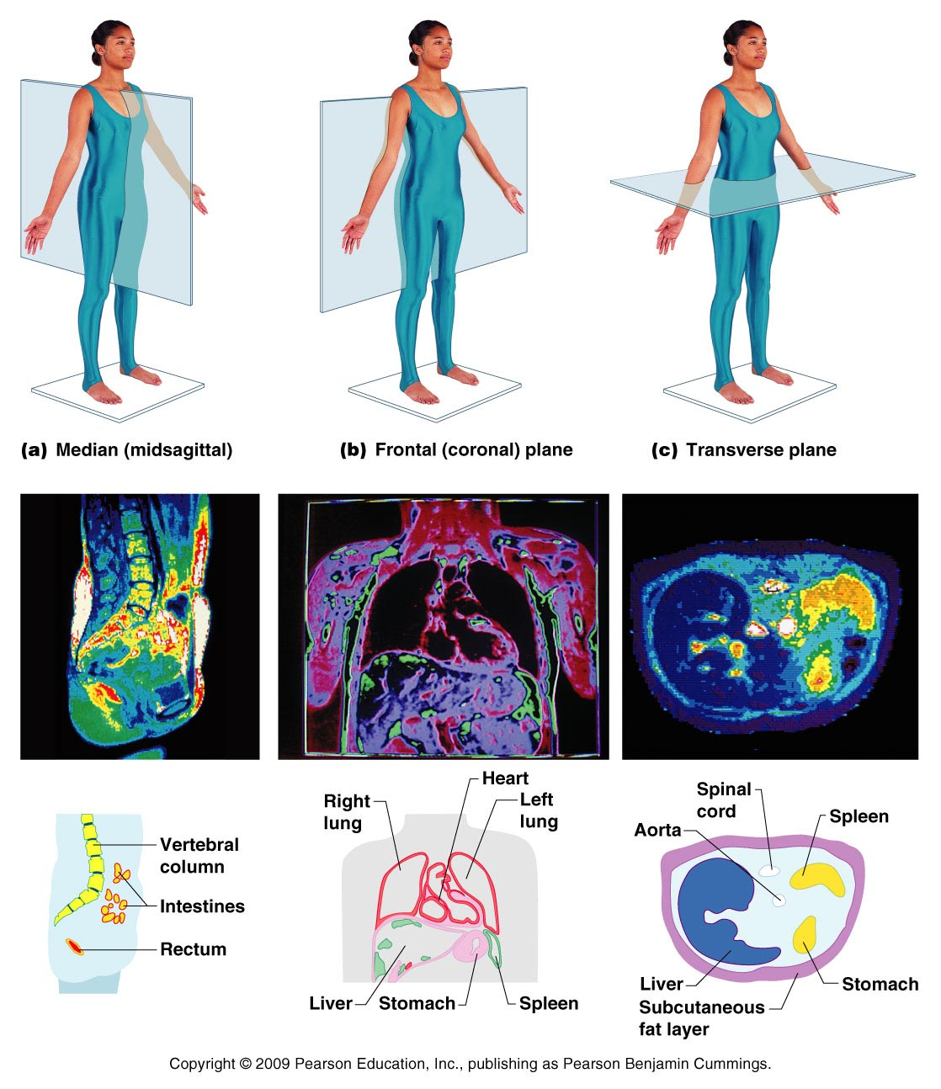
Anatomical Planes & Sections

Slide 18
Anatomical Planes
1
3
2
4
5

Slide 19
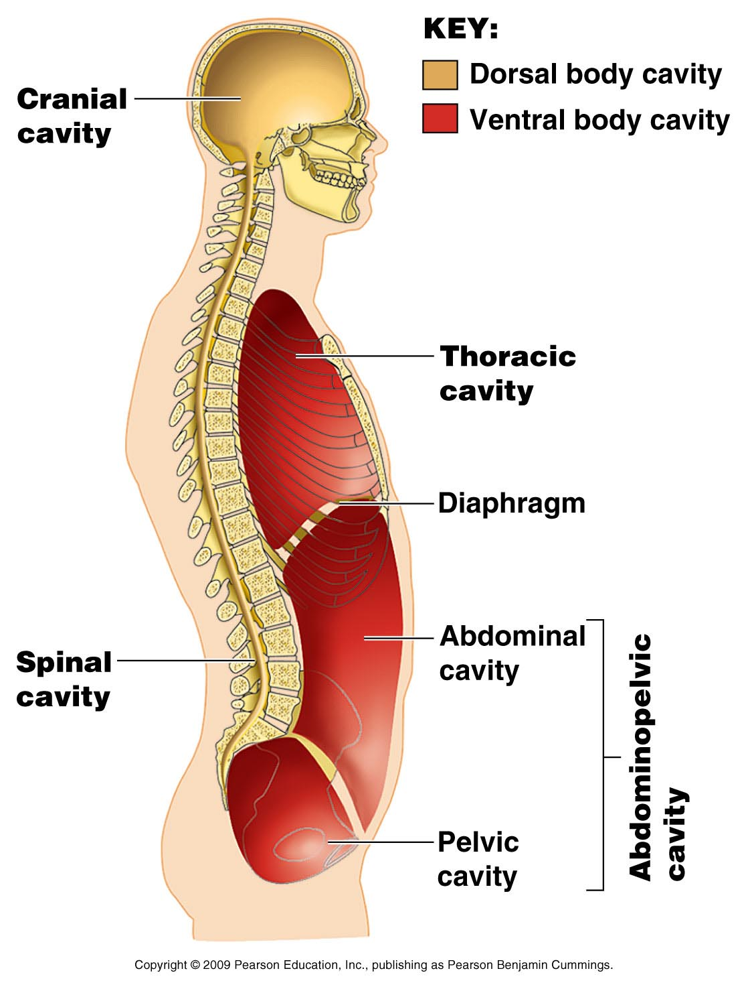
Body Cavities
Use 2 different colors to identify the 2 major body cavities on your Body Cavities diagram wkst!!
Cavity – hollow area within the body
Dorsal body cavity
Cranial cavity houses the brain
Spinal cavity houses the spinal cord
Ventral body cavity
Thoracic cavity houses heart, lungs & others
Abdominopelvic cavity houses digestive system & most urinary system organs

Slide 20
Anterior VIEW of Body Cavities
Cranial
cavity
Key:
Dorsal body cavity
Ventral body cavity
Vertebral
cavity
Thoracic
cavity
(contains
heart
and lungs)
Superior
mediastinum
Pleural
cavity
Pericardial
cavity within
the mediastinum
Diaphragm
Ventral body cavity (thoracic
and abdominopelvic
cavities)
Abdominal cavity
(contains digestive
viscera)
Abdomino-
pelvic
cavity
Pelvic cavity
(contains bladder,
reproductive organs,
and rectum)
(b) Anterior view
Figure 1.9b

Slide 21
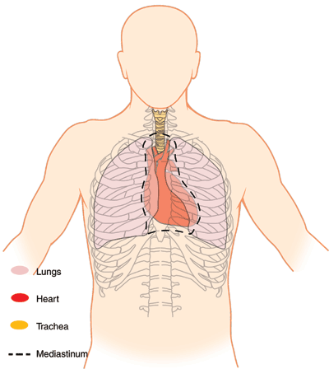
Thoracic Cavity
Divided into:
Diaphragm – flat muscular sheet that divides ventral cavity into superior thoracic cavity & inferior adbominopelvic cavity
Lateral Pleural Cavities – contain lungs
Mediastinum – contains heart, esophagus, thymus, trachea
Pericardial Cavity – small chamber that surrounds heart
Superior Mediastinum
Pleural Cavity
Pericardial cavity
Color code your diagram!

Slide 22
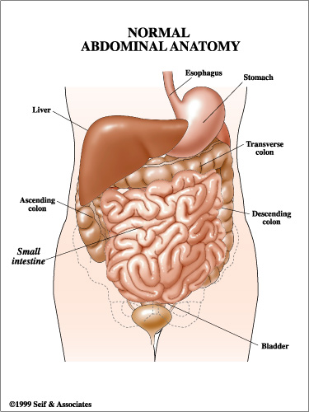
Abdominopelvic Cavity
Abdominal Cavity – stomach, intestines, spleen, liver & other organs
Pelvic Cavity – bladder, some reproductive organs, rectum
Serous membranes – lines walls of internal cavities & covers surface of viscera
Visceral – covers visceral organs
Parietal – lines inner surface of body wall or chamber

Slide 23
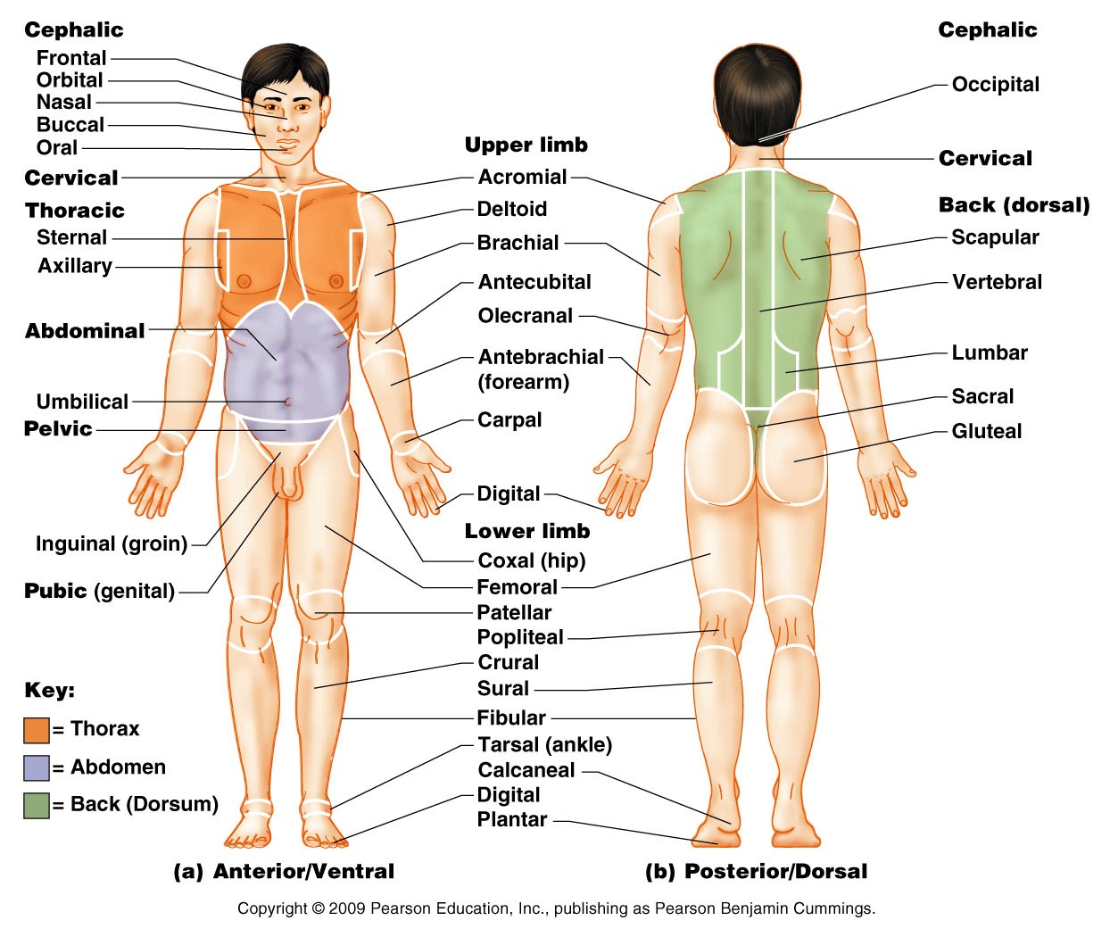
Body Regions
Use this diagram to fill in & color-code your own!

Slide 24
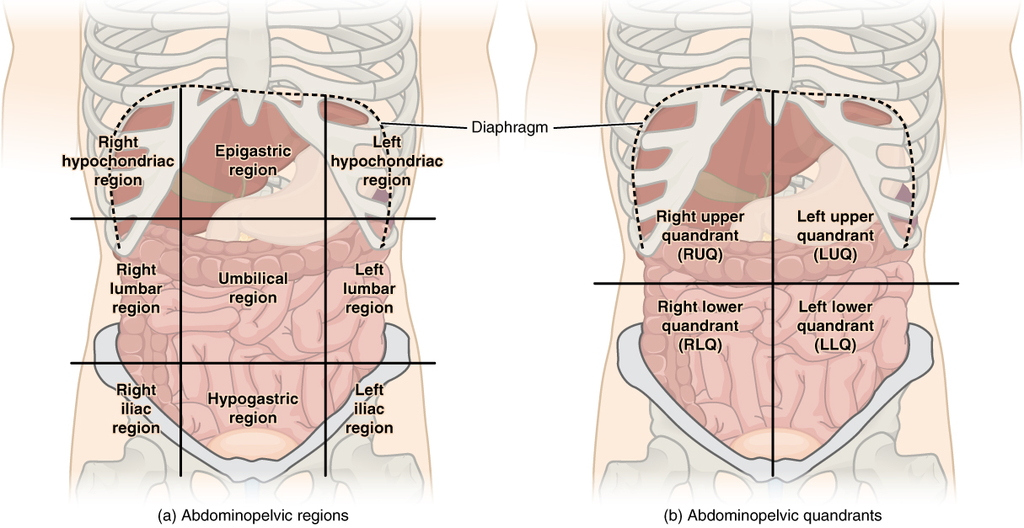
Abdominopelvic quadrants & regions
Use this diagram to identify each AP Quadrant & Region!

Slide 25
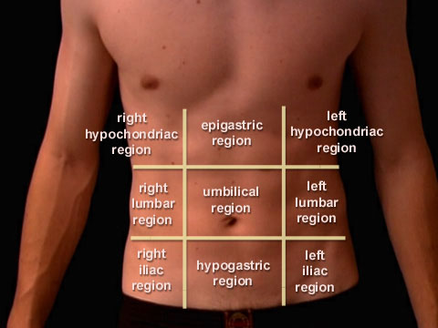
Abdominopelvic REGIONS
R & L hypochondriac chondriac = cartilage
Epigastric epi = on gastric = stomach
R & L lumbar lumbar = back
Umbilical
R & L iliac (inguinal) - hip
Hypogastric hypo = under
HEH
LUL
IHI

